Slide 1



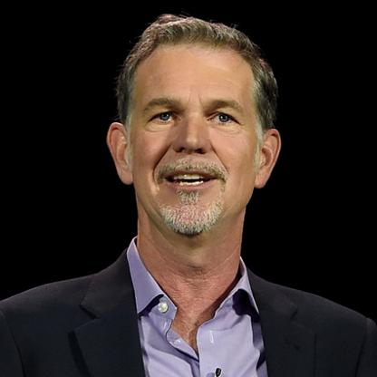

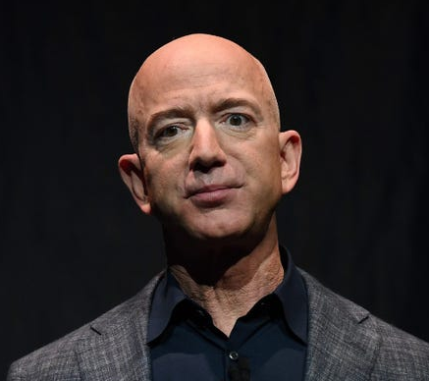
Jeff Bezos
Mark Zuckerberg
Reed Hastings

Slide 2
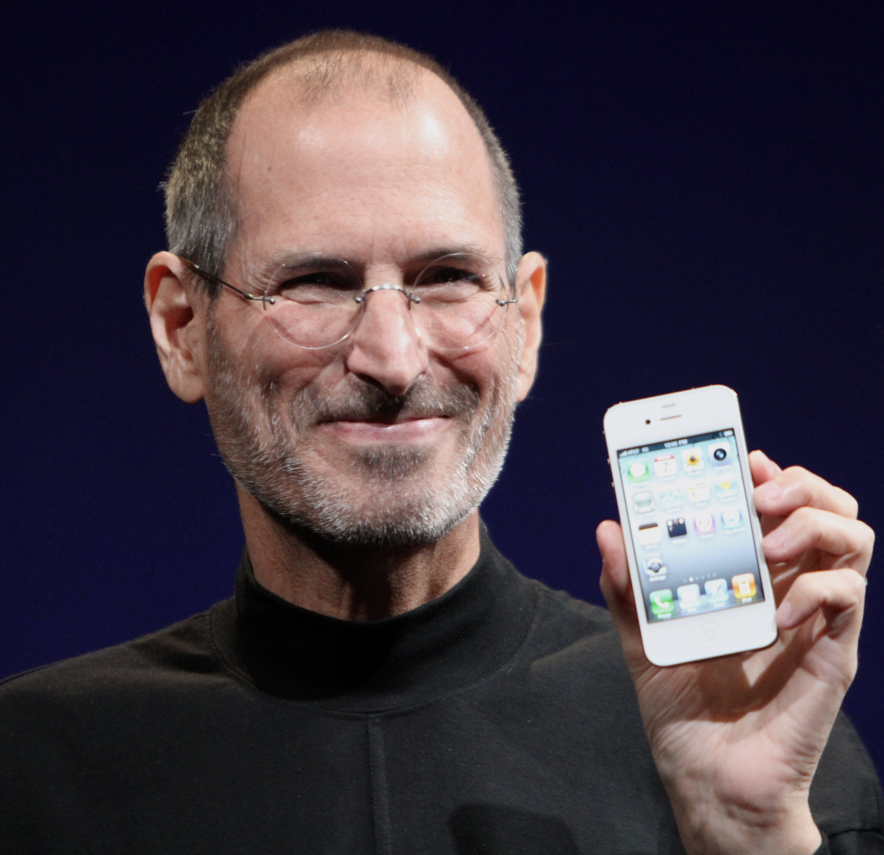


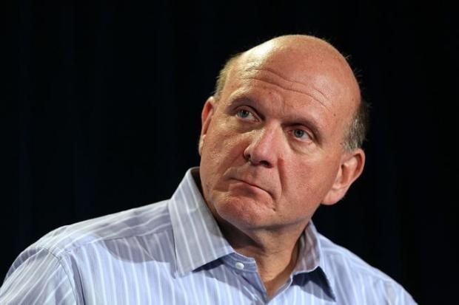
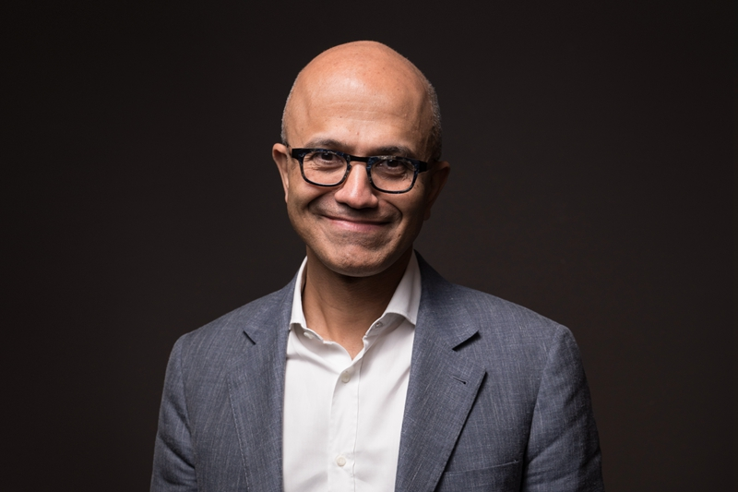

2009/2011:
Steve Jobs
→
Tim Cook
2014:
Steve Ballmer
→
Satya Nadella

Slide 3

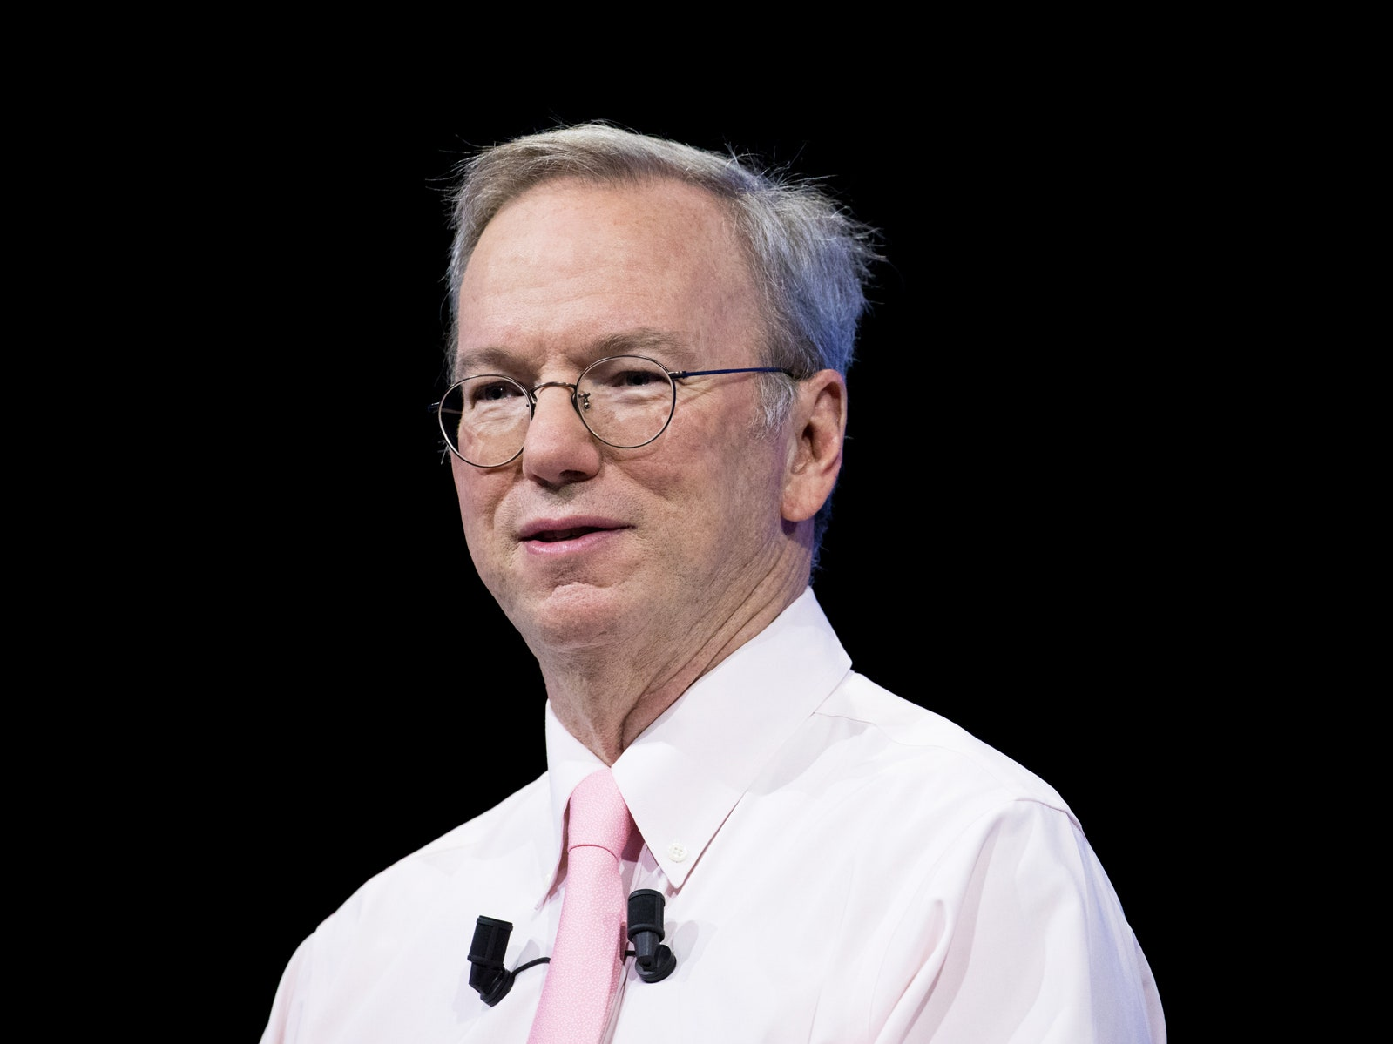
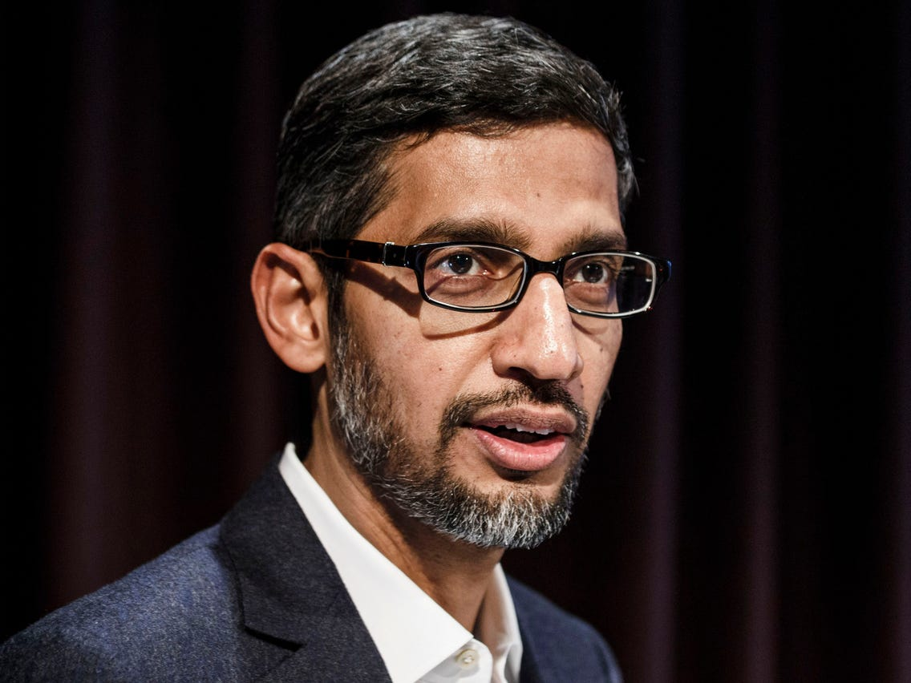
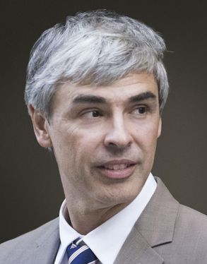
2011
2015
Eric Schmidt → Larry Page → Sundar Pichai

Slide 4




Hypothesis
CEO turnover → company cultural change
Magnitude of change
>

Slide 5

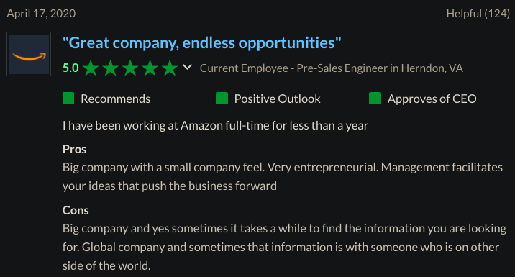

Slide 6
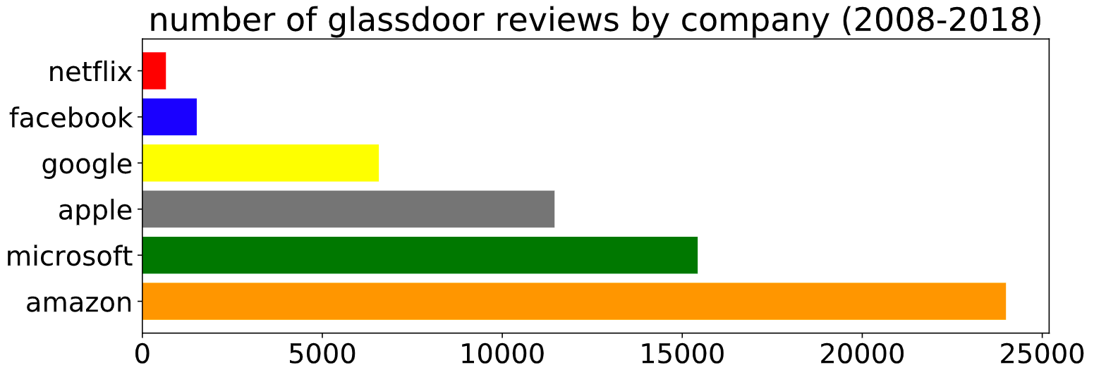
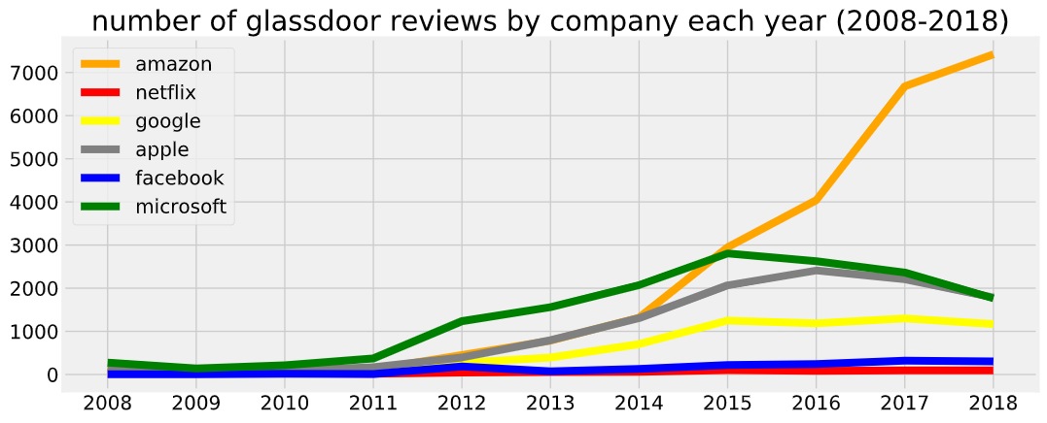
655
1511
6570
11452
15428
23992

Slide 7
1. Divergence heatmaps (2008-2018)
Non-stop words
For years in each company with more than 100 reviews, randomly sample 100 reviews.
Clear, consistent pattern from KS and Wasserstein graphs

Slide 8
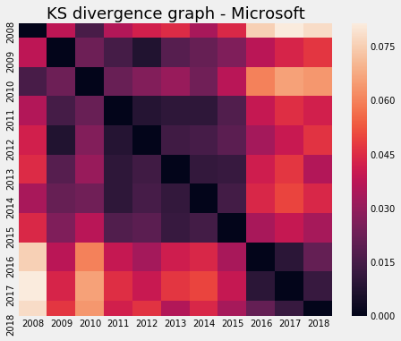
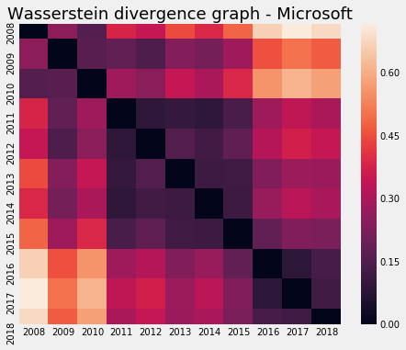
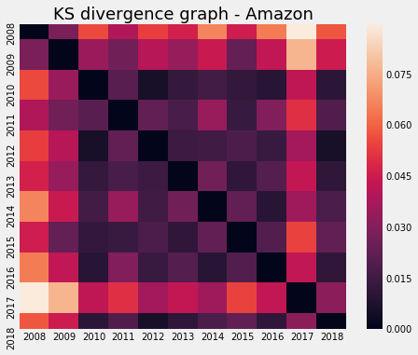
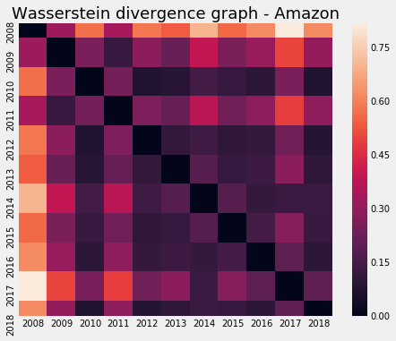
2014

Slide 9
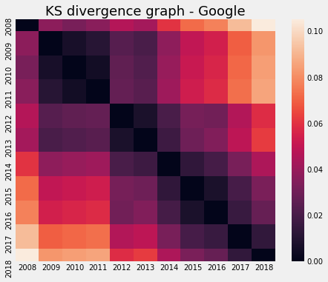
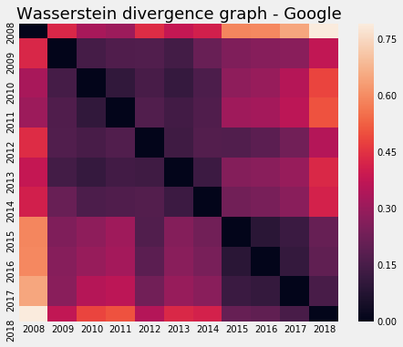
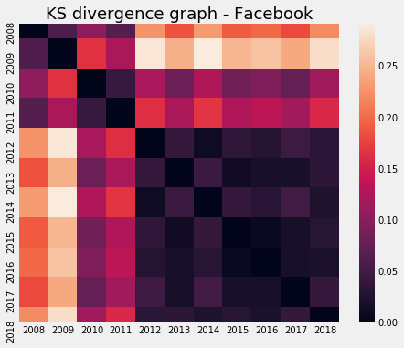
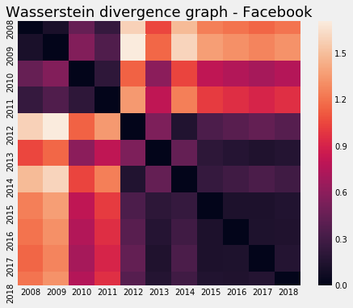
2011, 2015
Fewer than 20 reviews per year before 2012

Slide 10
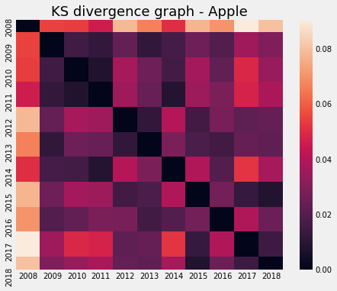
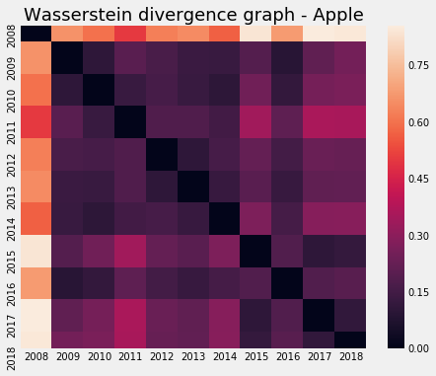
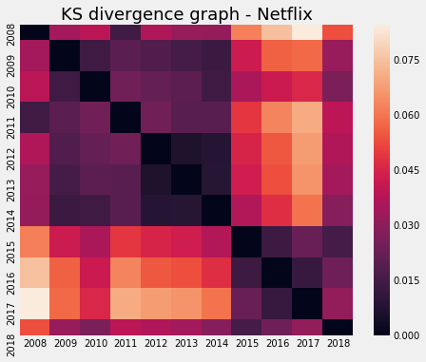
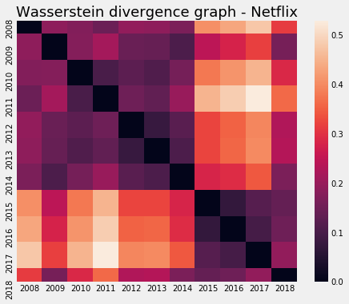
2009-2011

Slide 11










2. Counting Keyword occurrence per 10,000 reviews (2008-2018)
9 Values | Keywords
Agility | agil*, flexib*, nimble, fast
Collaboration | Collaborat*, teamwork, cooperat*, colleague*, coworker*, help*
Customer | customer*, client*
Diversity | divers*, inclusi*, welcom*, accepted, embraced, equitable
Execution | execut*, empower*, own*
Innovation | Cutting, edge, change, innovate*, creat*
Integrity | integrity, ethic*, honest*, right, moral*, character, honor*
Performance | Meritocra*, result*, outcome, perform*
Respect | Respect*, dignity, courtesy, friendly, appreciat*, care

Slide 12
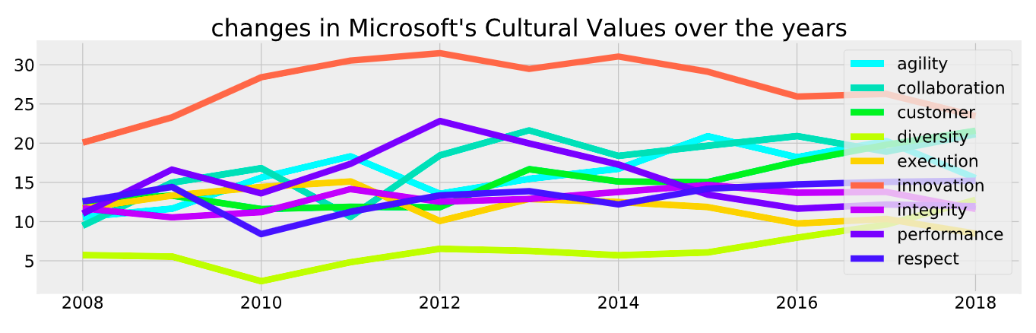
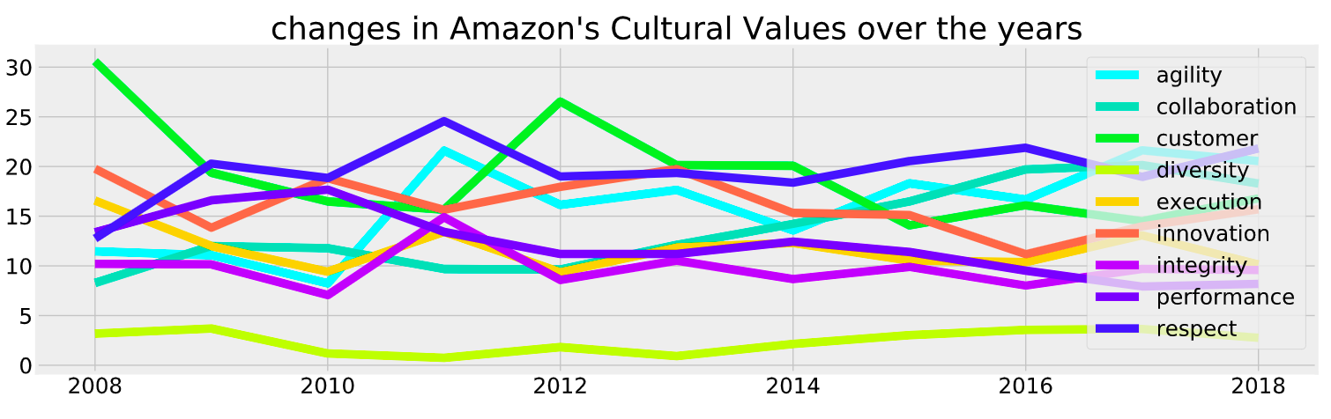
2014

Slide 13
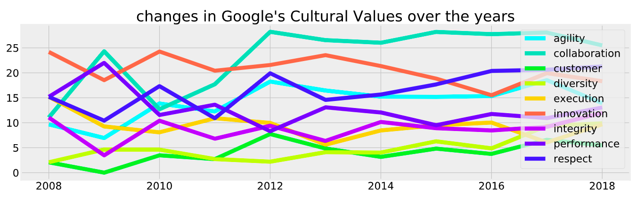
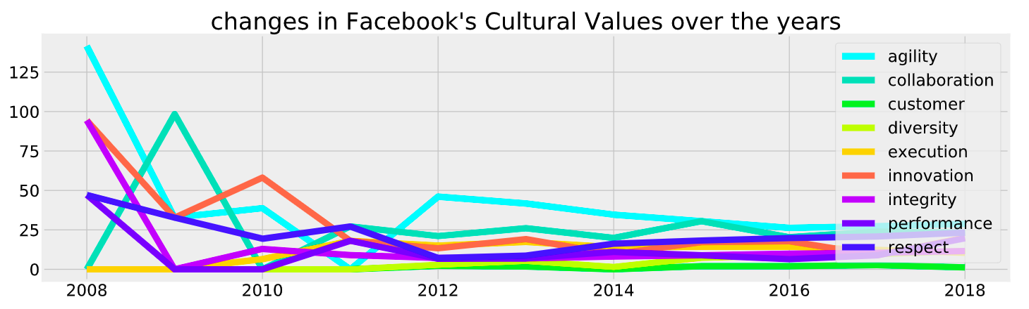
2011, 2015
Fewer than 20 reviews per year before 2012

Slide 14
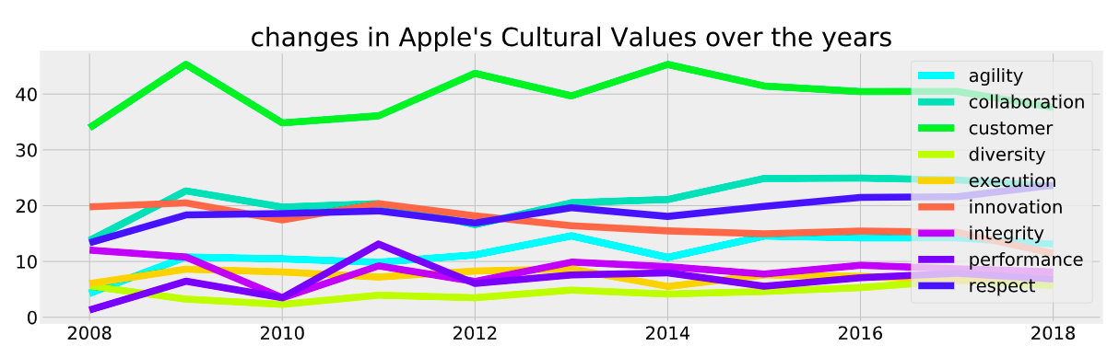
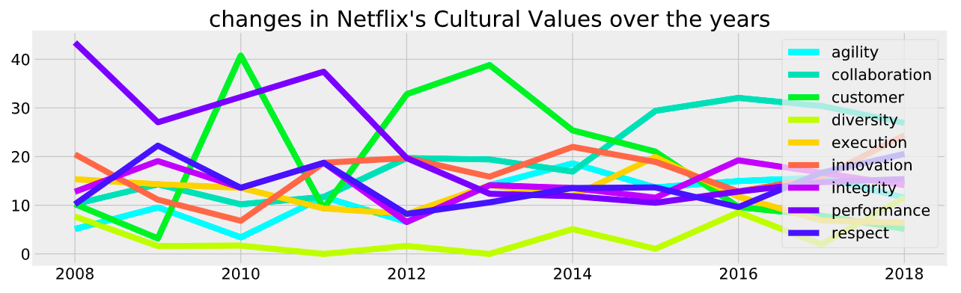
2009-2011

Slide 15

3. Projection (2009 – 2018)
‘good’, ‘great’, ‘high’
‘bad’, ‘poor’, ‘low’

Slide 16



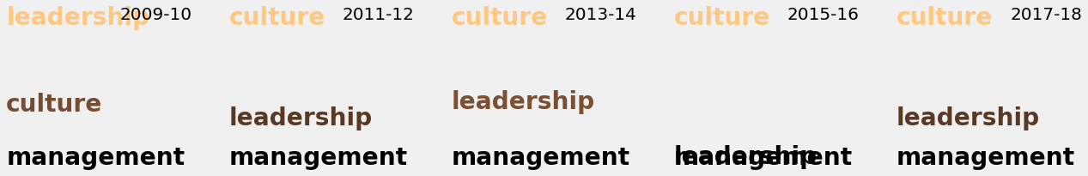

Slide 17
4. Classification methods
Distinguish between reviews from 2012-13 vs 2016-17
Hypothesis:
Prediction accuracies for
companies with a CEO turnover:
are better than for companies
without a CEO turnover:
2014
2011, 2015
2009-2011

Slide 18
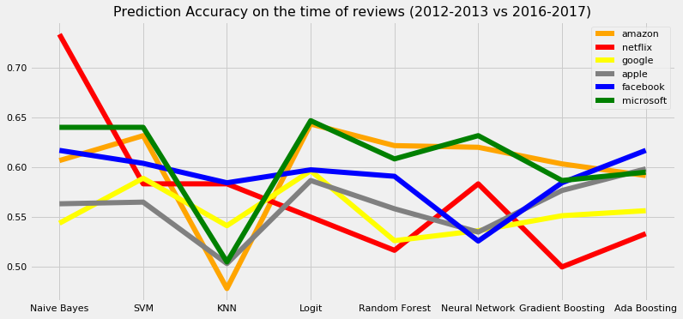

Does not support the hypothesis

Slide 19
Most influential words (Naïve Bayes)
Google |  | Microsoft
2012-13 | 2016-17 | 2012-13 | 2016-17
thing | pay | rank | hour
product | think | performance | customer
awesome | world | competitive | role
office | challenge | stack | project
feel | need | make | think
need | experience | market | support

Slide 20
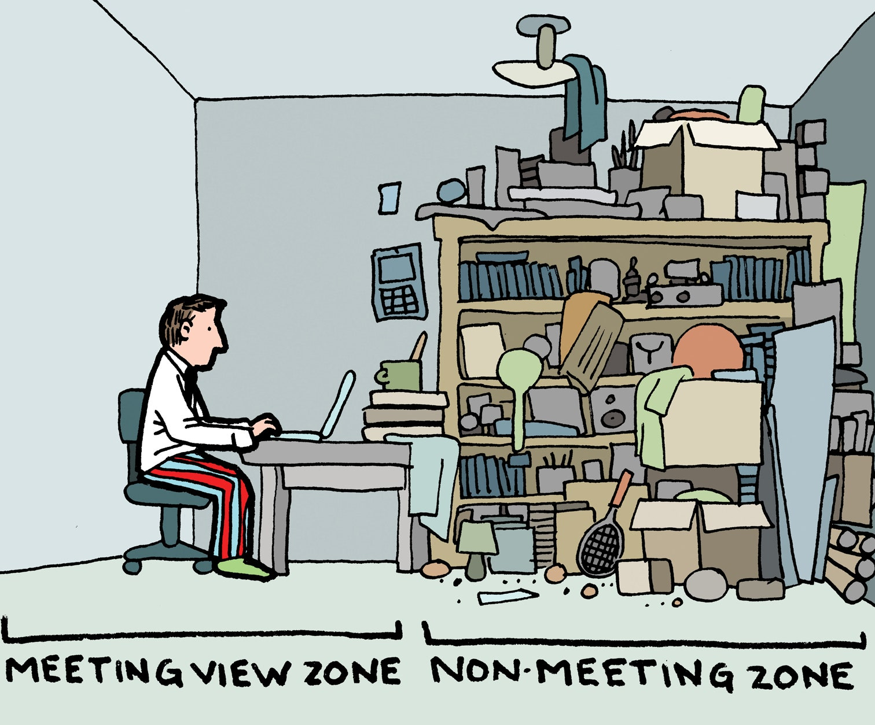
Thank you!

